Slide 1
Performance Evaluation
of Information Retrieval Systems
Dik Lun LEE Department of Computer Science, HKUST Slide <number>

Slide 2
Why is System Evaluation Needed?
There are many retrieval systems on the market, which one is the best?
When the system is in operation, is the performance satisfactory? Does it deviate from the expectation?
To fine tune a query to obtain the best result (for a particular set of documents and application)
To provide inputs to cost-benefit analysis of an information system (e.g., time saving compared to a manual system)
To determine the effects of changes made to an existing system (system A versus system B)
Efficiency: speed
Effectiveness: how good the result is?
Dik Lun LEE Department of Computer Science, HKUST Slide <number>

Slide 3
Difficulties in Evaluating IR System
Effectiveness is related to relevancy of items retrieved
Relevancy is not a binary evaluation but a continuous function
Even when relevancy judgment is binary, it is difficult to make a judgment
Relevancy, from a human judgment standpoint, is
  subjective - depends upon a specific user’s judgment
  situational - relates to user’s requirement
  temporal - changes over time
Dik Lun LEE Department of Computer Science, HKUST Slide <number>

Slide 4
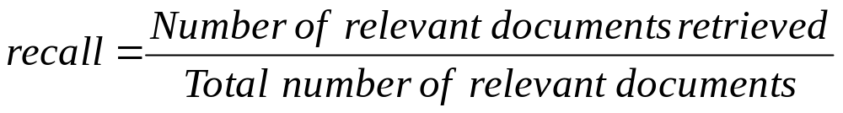
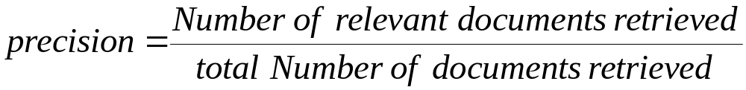
Retrieval Effectiveness - Precision and Recall
Entire document collection
retrieved & irrelevant
Not retrieved & irrelevant
irrelevant
Relevant documents
Retrieved documents
retrieved & relevant
not retrieved but relevant
relevant
retrieved
not retrieved
Dik Lun LEE Department of Computer Science, HKUST Slide <number>

Slide 5
Precision and Recall
Precision
  evaluates the correlation of the query to the database
  an indirect measure of the completeness of indexing algorithm
Recall
  the ability of the search to find all of the relevant items in the database
Among three numbers,
  only two are always available
    total number of items retrieved
    number of relevant items retrieved
  total number of relevant items is usually not available
Dik Lun LEE Department of Computer Science, HKUST Slide <number>

Slide 6
Relationship between Recall and Precision
Unfortunately, precision and recall affect each other in the opposite direction! Given a system:
  Broadening a query or increasing the number of returned documents will increase recall but lower precision
  Fine-tuning the weighing formula often makes one parameter better but the other worse
Results are mostly relevant but miss many relevant ones
The ideal
1
Return most of the
Relevant documents
but include many junks
precision
0
1
recall
Dik Lun LEE Department of Computer Science, HKUST Slide <number>

Slide 7
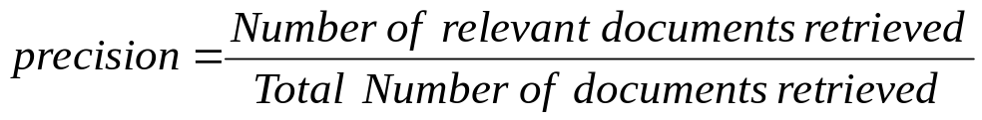
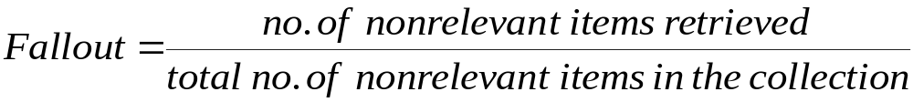
Fallout Rate
Problems with precision and recall:
  A query on “Hong Kong” will return most relevant documents but it doesn’t tell you how good or how bad the system is! (What is the chance that a randomly picked document is relevant to the query?)
  number of irrelevant documents in the collection is not taken into account
  recall is undefined when there is
  no relevant document in the
  collection
  precision is undefined when no
  document is retrieved
A good system should have high recall and low fallout
Dik Lun LEE Department of Computer Science, HKUST Slide <number>

Slide 8
Fallout (cont)
Fallout can be viewed as the inverse of recall
It is very unlikely to have situation as 0/0
  the number of non-relevant items in a collection can be safely be assumed to be non-zero.
It is the probability that a retrieved item is non-relevant. (Recall: the probability that a retrieved item is relevant)
Among three measures, precision, recall and fallout, fallout is least sensitive to the accuracy of the search process because it reflects the overall relevance of the collection to the query
A good system should have high recall and low fallout
Dik Lun LEE Department of Computer Science, HKUST Slide <number>

Slide 9
How to obtain Relevance Judgment?
Use human judges to evaluate a query against every document and decide if the document if relevant to the query or not
While human evaluation appears to be ideal for obtaining relevance judgment, it is:
  Very time consuming
  Prone to human error and inconsistency

Slide 10
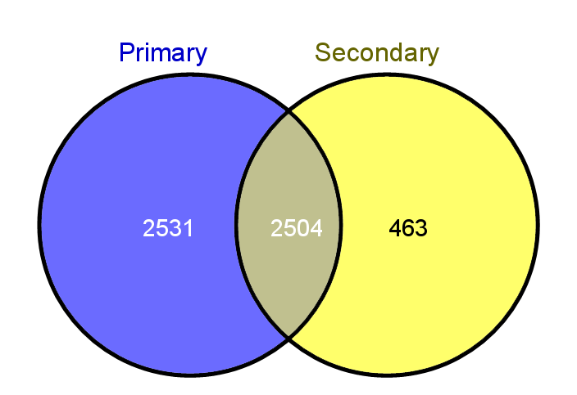
Human Judgments are Inconsistent
Two assessors, primary and secondary, evaluated the same set of documents
2,504 documents are assessed as relevant by both assessors
Totally, 2,531 + 2,504 + 463 = 5,498 documents are evaluated as relevant
Overlap = 2,504 ∕ 5,498 = 45.5%.

Slide 11
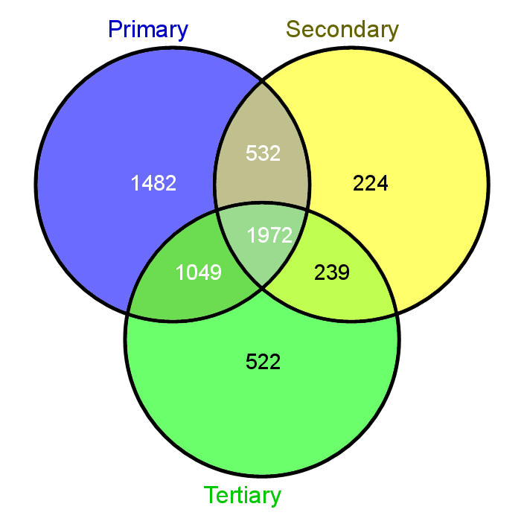
More Human Assessors Disagree Even More!
Three assessors evaluated the same set of documents
1,972 documents are assessed as relevant by all assessors
Totally, 1,482 + 532 + 224 + 1,972 + 1,049 + 239 + 522 = 6,020 documents are evaluated as relevant
Overlap = 1,972 / 6,020 = 32.8%.

Slide 12
How to handle the Inconsistency?
Identify one assessor, e.g., the primary assessor, as always correct; then, why need the secondary or tertiary assessors?
Take the majority vote; consider only the intersection as relevant documents
Ask an additional, authoritative judge to evaluate the inconsistent evaluations
In summary, human evaluation is inaccurate and expensive!
(Better) alternatives:
  Use automatic methods to filter out relevant documents, then use human judgment on the filtered results
  Automatic methods: search engine pooling, machine learning methods
  Use the human judged results to train an automatic method, and iterative the process

Slide 13
How to Find the Total Number of Relevant Items?
In an infinitely large collection (e.g., the web), it is unknown.
Note that we only need to know the number of relevant documents in a collection; no need to find the list of relevant documents
Two possible approaches to get an estimate:
  Sampling the collection and perform relevance judgment on the samples
Human relevance judgment
document sample (e.g., 2%)
1 billion documents
relevant documents
Dik Lun LEE Department of Computer Science, HKUST Slide <number>

Slide 14
How to Find the Total Number of Relevant Items?
Apply different retrieval algorithms to the same database for the same query. The aggregate of relevant items is taken as the total number of relevant documents in the collection (biased sampling)
R₂
Query
R₁
R₃
Human relevance judgment
Alg 1
Alg 2
Alg 3
relevant documents
1 billion documents
R₁ ∪ R₂ ∪ R₃
Dik Lun LEE Department of Computer Science, HKUST Slide <number>

Slide 15
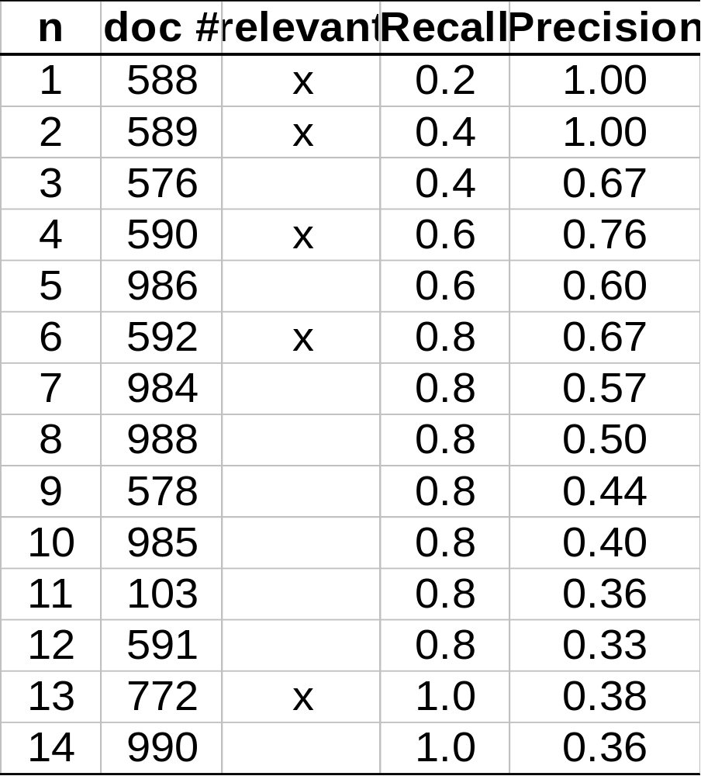
Computation of Recall and Precision
Suppose:
total no. of relevant docs = 5
R=1/5=0.2; p=1/1=1
R=2/5=0.4; p=2/2=1
R=2/5=0.4; p=2/3=0.67
R=5/5=1; p=5/13=0.38
Dik Lun LEE Department of Computer Science, HKUST Slide <number>

Slide 16
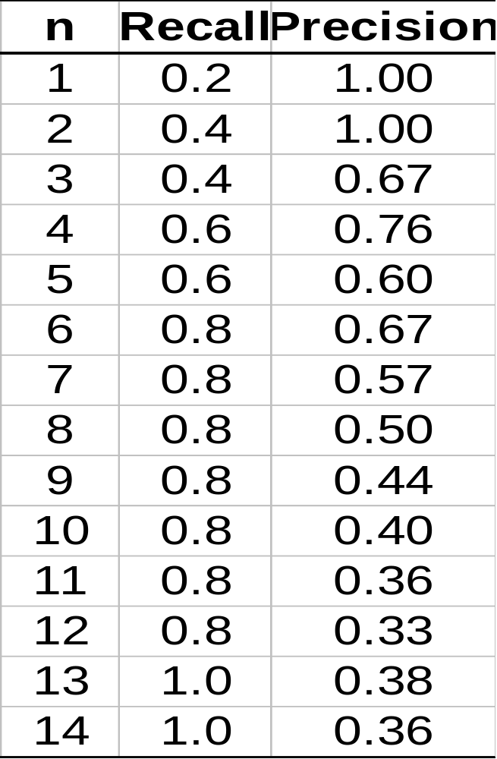
Computation of Recall and Precision
precision
1
2
1.0
0.8
4
6
0.6
3
5
7
0.4
13
12
0.2
200
0.2
0.4
0.6
0.8
1.0
recall
Dik Lun LEE Department of Computer Science, HKUST Slide <number>

Slide 17
Interpolated Recall-Precision Graph
For certain recall (precision), precision (recall) is not specified
For more than one curve (query), how to get the average one?
Using interpolated curve -- the best performance a user can achieve
interpolated
original
1.0
x
x
0.8
x
x
0.6
0.4
x
0.2
0.2
0.6
1.0
Dik Lun LEE Department of Computer Science, HKUST Slide <number>

Slide 18
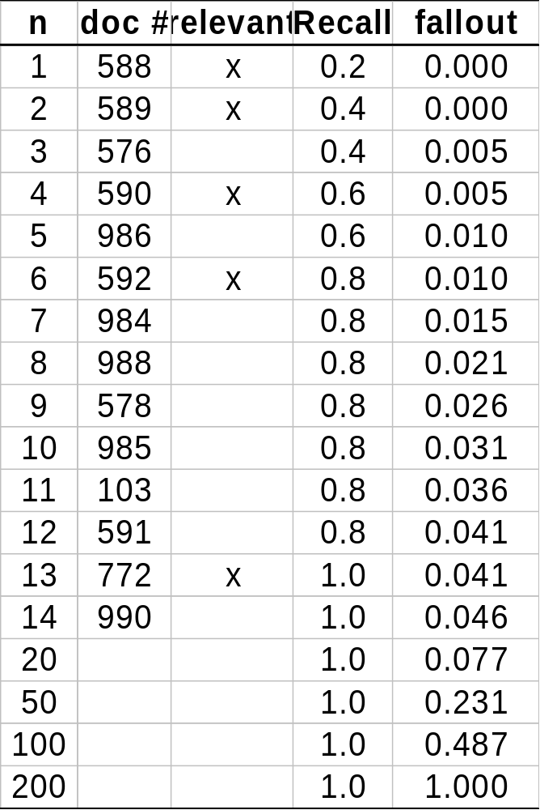
Recall-Fallout Graph
F=1/195=0.005
Recall
1.0
0.8
0.6
0.4
0.005
0.01
0.04
0.975
fallout
Dik Lun LEE Department of Computer Science, HKUST Slide <number>

Slide 19
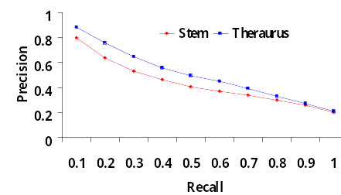
Compare Two or More Systems
The curve closest to the upper right-hand corner of the graph indicates the best performance
When a system is better than the other system in one segment (e.g., at low recall) but worse in another segment (e.g., at high recall), is it better or worse than the other system?
Are the ranks of the returned relevant documents considered in precision and recall computation?
Tool to produce P/R graph: http://trecvid.nist.gov/trecvid.tools/trec_eval_video/README
Dik Lun LEE Department of Computer Science, HKUST Slide <number>

Slide 20
More Performance Measures
Dik Lun LEE Department of Computer Science, HKUST Slide <number>

Slide 21
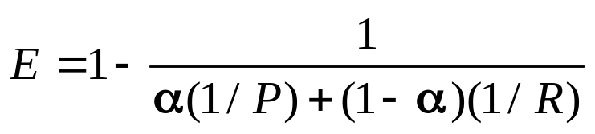
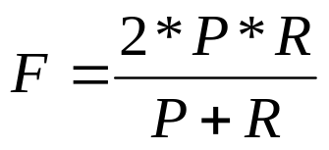

Single-Valued Measures
Desirable properties for an ideal effectiveness measure
  Reflect retrieval effectiveness alone
  Independent of any particular retrieval cutoff, e.g., the number of documents retrieved in a search
  A single number if possible
E-measure:
  Large values of the recall (R) and precision (P) correspond to small values of E; when P = R = 1, E = 0
  α = 1 means user is interested in P only
F-measure (harmonic mean): E-measure at α=0.5
F_{β} = 1 − E where α = 1 / (β² + 1).
Dik Lun LEE Department of Computer Science, HKUST Slide <number>

Slide 22
Other Commonly Used Measures
Precision at K or Top-k precision
  Number of relevant documents / k
  Notations:
    Top-1 precision, Top-5 precision, Top-10 precision
    precision@1, precision@5, precision@10, etc.
Dik Lun LEE Department of Computer Science, HKUST Slide <number>

Slide 23
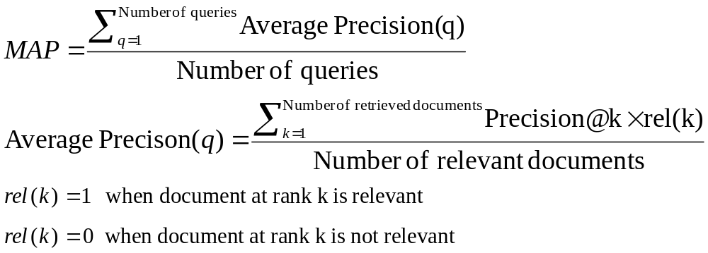
Other Commonly Used Measures
Mean Average Precision (MAP)
Result(q): | D₁ | D₂ | D₃ | D₄ | D₅ | D₆ | D₇ | D₈ | D₉ | D₁₀
rel(k) | 1 | 0 | 0 | 1 | 1 | 0 | 1 | 0 | 1 | 1
AP(q) = ( 1 + 2/4 + 3/5 + 4/7 + 5/9 + 6/10 ) / 6 = 0.638
Dik Lun LEE Department of Computer Science, HKUST Slide <number>

Slide 24
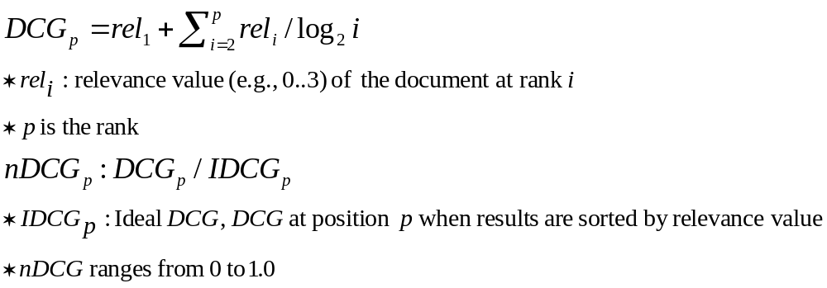
Other Commonly Used Measures
Discounted Cumulative Gain (DCG)
  Relevance score is not binary: irrelevant (0), somewhat relevant (1), relevant (2), very relevant (3), etc.
  Measure the usefulness (or gain) of a document at a certain rank
  Highly relevant documents with low rank should be penalized logarithmically proportional to k
Dik Lun LEE Department of Computer Science, HKUST Slide <number>

Slide 25
Example on Computing NDCG
Documents | D₁ | D₂ | D₃ | D₄ | D₅ | D₆
Relevance scores | 3 | 2 | 3 | 0 | 1 | 2
  CG₆ = ∑⁶_{i=1} rel_{i} = 3 + 2 + 3 + 0 + 1 + 2 = 11
  DCG₆ = rel₁ + ∑⁶_{i=2} rel_{i} /log₂i
  = 3 + (2 + 1.887 + 0 + 0.431 + 0.772) = 8.09
  Ideal ranking obtained by sorting the relevance scores: 3, 3, 2, 2, 1, 0
  IDCG₆ = 8.693
  nDCG₆ = DCG₆ / IDCG₆ = 8.09 / 8.693 = 0.9306
Dik Lun LEE Department of Computer Science, HKUST Slide <number>

Slide 26
Subjective Relevance Measure
Novelty Ratio: the proportion of items retrieved and judged relevant by the users of which they had not been aware prior to receiving the search output
  usefulness of the results
Coverage Ratio: the proportion of relevant items retrieved out of the total relevant documents known to users prior to the search
  a very essential requirement: e.g., I want to locate a document which I have seen before (e.g., the budget report for Year 2000)
Sought recall: the total number of documents examined by the user following a search, divided by the total number of relevant documents which the user would like to examine.
  Precision and user interface of the system: e.g., consider the web, how many pages do I have to click into before I am satisfied with the search
Dik Lun LEE Department of Computer Science, HKUST Slide <number>

Slide 27
Other Factors to Consider
user effort: intellectual or physical, required from the users in formulating the queries, conducting the search, and screening the output
  user interface, query language, etc.
response time: the time interval between receipt of a user query and the presentation of system responses
  tradeoff between response time and retrieval effectiveness
form of presentation of the search output which influence the users’ ability to utilize the retrieved materials
  user interface
collection coverage: the extent to which all relevant items are included in the system
  quality of the collection; the best retrieval algorithm will return junk on collections that contain only junk! (important for web-based search engines)
Dik Lun LEE Department of Computer Science, HKUST Slide <number>

Slide 28
Benchmarking
Dik Lun LEE Department of Computer Science, HKUST Slide <number>

Slide 29
Experimental Setup for Benchmarking
It is very difficult to obtain analytical performance (of retrieval effectiveness) for document retrieval systems, because many characteristics of the documents such as relevance, distribution of words, etc., are difficult to describe with mathematical formula.
Performance is measured by benchmarking. That is, the retrieval effectiveness of a system is evaluated on a given set of documents, queries, and relevance judgment. This is analogous to benchmarking of computing systems.
Performance data is valid only for the environment under which the system is evaluated.
Dik Lun LEE Department of Computer Science, HKUST Slide <number>

Slide 30
Benchmarking − The Ideal
A benchmark collection contains:
  A set of standard documents and queries
  A list of relevant documents for each query
Standard collections for traditional IR:
  Smart collection: ftp://ftp.cs.cornell.edu/pub/smart
  TREC: http://trec.nist.gov/
Retrieved result
Precision and recall
Standard document collection
Algorithm under test
Evaluation
Standard queries
Standard result
Dik Lun LEE Department of Computer Science, HKUST Slide <number>

Slide 31
Benchmarking − The Problems
Performance data is valid only for a particular benchmark
Extremely resource consuming (large document collection)
No good benchmark for the web
No good benchmark for Asian languages
May expose your system’s weaknesses to your customers!
Dik Lun LEE Department of Computer Science, HKUST Slide <number>

Slide 32
TREC and Earlier Test Collections
Dik Lun LEE Department of Computer Science, HKUST Slide <number>

Slide 33
Early Test Collections
Previous experiments were based on the SMART collection which is very small. (ftp://ftp.cs.cornell.edu/pub/smart)
Collection Number Of Number Of Raw Size
Name Documents Queries (Mbytes)
CACM 3,204 64 1.5
CISI 1,460 112 1.3
CRAN 1,400 225 1.6
MED 1,033 30 1.1
TIME 425 83 1.5
Different researchers used different test collections and evaluation techniques.
Dik Lun LEE Department of Computer Science, HKUST Slide <number>

Slide 34
The TREC Benchmark
TREC: Text Retrieval Conference
Originated from the TIPSTER program sponsored by Defense Advanced Research Projects Agency (DARPA)
Became an annual conference in 1992, co-sponsored by the National Institute of Standards and Technology (NIST) and DARPA
Participants are given parts of a standard set of documents and queries in different stages for testing and training
Participants submit the P/R values on the final document and query set and present their results in the conference
http://trec.nist.gov/
Dik Lun LEE Department of Computer Science, HKUST Slide <number>

Slide 35
The TREC Objectives
Give a common ground for comparing different IR techniques
  same set of documents and queries, and same evaluation method
Sharing of resources and experiences in developing the benchmark
  with major sponsorship from government to develop large benchmark collections
Encourage participation from industry and academia
Development of new evaluation techniques, particularly for new applications
  retrieval, routing/filtering, non-English collection, web-based collection
Dik Lun LEE Department of Computer Science, HKUST Slide <number>

Slide 36
TREC Advantages
Large scale (compared to a few Mbytes in the Cornell Collection)
Relevance judgments provided
Under continuous development and with support from US Government
Wide participation: TREC 1 (’92): 28 papers 360 pages; TREC 4: 37 papers 560 pages; TREC 7: 61 papers 600 pages; TREC 8: 74 papers; TREC 9: 64 papers; TREC 10 (’01): 79 papers; TREC 2004: 97 papers; TREC 2005: 125 papers; TREC 2006: 112 papers … …
Dik Lun LEE Department of Computer Science, HKUST Slide <number>

Slide 37
TREC Tasks
Ad hoc - new questions are being asked on the static set of data. (library catalog searching)
Routing - same questions are being asked, but the new information is being searched. (news clipping, library profiling)
New tasks added after TREC 5 - Interactive, multilingual, natural language, multiple database merging, filtering, very large corpus (20 Gbytes of 7.5 million documents)
Dik Lun LEE Department of Computer Science, HKUST Slide <number>

Slide 38
TREC Collections
TREC evaluates both Ad hoc and routing queries and provides both training and test collections:
  50 training topics + 1 Gbytes of training documents + relevance judgement
  50 test topics + 1 Gbytes of test documents
  Adhoc: runs the 50 test topics on both training and test documents
  Routing: trains the system with training queries and documents and then tests it on the unseen test documents.
Routing
queries
Training queries
50 training topics
Training documents
(~ 1Gbytes)
Testing documents
(~ 1Gbytes)
50 testing topics
Ad-hoc queries
Dik Lun LEE Department of Computer Science, HKUST Slide <number>

Slide 39
Characteristics of the TREC Collection
both long and short documents (from a few hundred to over one thousand unique terms in a document)
test documents consist of:
WSJ Wall Street Journal articles (1986-1992) 550 M
AP Associate Press Newswire (1989) 514 M
ZIFF Computer Select Disks (Ziff-Davis Publishing) 493 M
FR Federal Register 469 M
DOE Abstracts from Department of Energy reports 190 M
Dik Lun LEE Department of Computer Science, HKUST Slide <number>

Slide 40
More Details on Document Collections
Volume 1 (Mar 1994) - Wall Street Journal (1987, 1988, 1989), Federal Register (1989), Associated Press (1989), Department of Energy abstracts, and Information from the Computer Select disks (1989, 1990)
Volume 2 (Mar 1994) - Wall Street Journal (1990, 1991, 1992), the Federal Register (1988), Associated Press (1988) and Information from the Computer Select disks (1989, 1990)
Volume 3 (Mar 1994) - San Jose Mercury News (1991), the Associated Press (1990), U.S. Patents (1983-1991), and Information from the Computer Select disks (1991, 1992)
Volume 4 (May 1996) - Financial Times Limited (1991, 1992, 1993, 1994), the Congressional Record of the 103rd Congress (1993), and the Federal Register (1994).
Volume 5 (Apr 1997) - Foreign Broadcast Information Service (1996) and the Los Angeles Times (1989, 1990).
Dik Lun LEE Department of Computer Science, HKUST Slide <number>

Slide 41
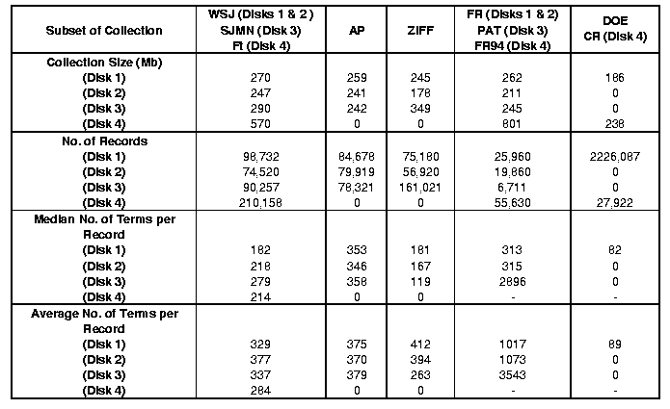
TREC Detailed Statistics (Disks1-4)
Dik Lun LEE Department of Computer Science, HKUST Slide <number>

Slide 42
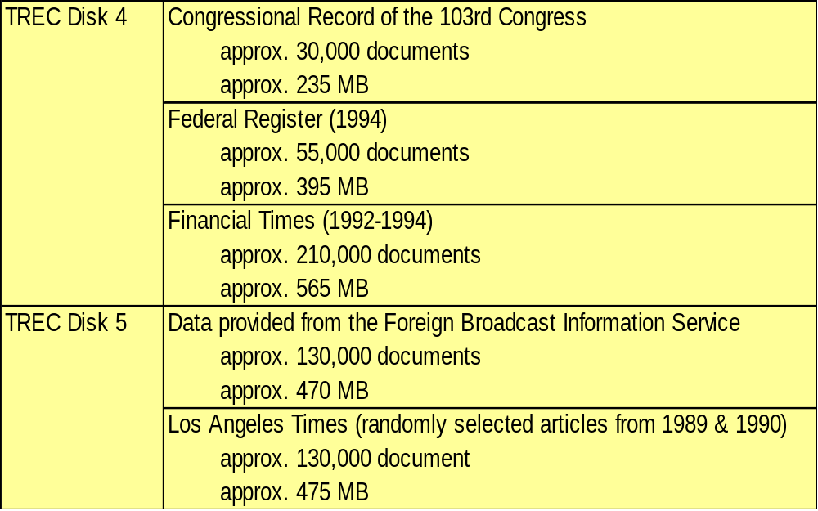
TREC Disk 4,5
Dik Lun LEE Department of Computer Science, HKUST Slide <number>

Slide 43
Sample Document -- Marked Up in SGML
<DOC>
<DOCNO> WSJ870324-0001 </DOCNO>
<HL> John Blair Is Near Accord To Sell Unit, Sources Say </HL>
<DD> 03/24/87</DD>
<SO> WALL STREET JOURNAL (J) </SO>
<IN> REL TENDER OFFERS, MERGERS, ACQUISITIONS (TNM) MARKETING, ADVERTISING (MKT) TELECOMMUNICATIONS, BROADCASTING, TELEPHONE, TELEGRAPH (TEL) </IN>
<DATELINE> NEW YORK </DATELINE>
<TEXT>
John Blair &amp; Co. is close to an agreement to sell its TV station advertising representation operation and program production unit to an investor group led by James H. Rosenfield, a former CBS Inc. executive, industry sources said. Industry sources put the value of the proposed acquisition at more than $100 million. ...
</TEXT>
</DOC>
Dik Lun LEE Department of Computer Science, HKUST Slide <number>

Slide 44
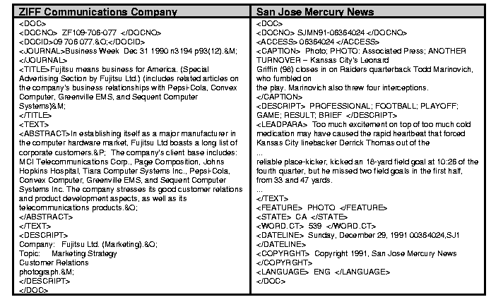
TREC Documents with More Details
Dik Lun LEE Department of Computer Science, HKUST Slide <number>

Slide 45
Sample Query -- Marked Up with SGML
<top>
<head> Tipster Topic Description
<num> Number: 066
<dom> Domain: Science and Technology
<title> Topic: Natural Language Processing
<desc> Description: Document will identify a type of natural language processing technology which is being developed or marketed in the U.S.
<narr> Narrative: A relevant document will identify a company or institution developing or marketing a natural language processing technology, identify the technology, and identify one of more features of the company's product.
<con> Concept(s):
1. natural language processing; 2. translation, language, dictionary, font …
<fac> Factor(s):
<nat> Nationality: U.S.
</fac>
<def> Definitions(s):
</top>
Dik Lun LEE Department of Computer Science, HKUST Slide <number>

Slide 46
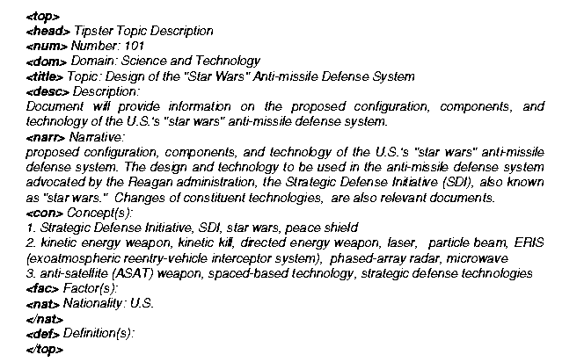
Another Example of TREC Topic/Query
Dik Lun LEE Department of Computer Science, HKUST Slide <number>

Slide 47
A Difficult Topic Example
<num> Number: 351
<title> Falkland petroleum exploration
<desc> Description:
What information is available on petroleum exploration in the South Atlantic near the Falkland Islands?
<narr> Narrative:
Any document discussing petroleum exploration in the South Atlantic near the Falkland Islands is considered relevant. Documents discussing petroleum exploration in continental South America are not relevant.

Slide 48
Sample Query -- Marked Up with SGML
Both documents and queries contain many different kinds of information (fields)
Generation of the formal queries (Boolean, Vector Space, etc) is the responsibility of the system
  A system may be very good in querying and ranking, but if it generates poor queries from the topic, its final P/R would be poor
Dik Lun LEE Department of Computer Science, HKUST Slide <number>

Slide 49
Relevance Judgment
Exhaustive evaluation:
  100 topics * 742611 documents = over 74 million judgements
Sampling:
  a topic has on average 200 and maximum 900 relevant documents, the sample size is still too large
Polling:
  Combine the retrieved documents from each system under test and perform relevance judgment on the combined documents
  33 runs of 200 top documents: 2398 documents per topic
  22 runs of 100 top documents: 1932 documents per topic (only 450 documents less than the larger combination)
Dik Lun LEE Department of Computer Science, HKUST Slide <number>

Slide 50
Evaluation
Summary table statistics: number of topics, number of documents retrieved, number of relevant documents
Recall-precision average: average precision at 11 recall levels (0 to 1 at 0.5 increment)
Document level average: average precision when 5, 10, .., 100, … 1000 documents are retrieved
Average precision histogram: average precision for each topic against the medium precision of all systems for that topic
Dik Lun LEE Department of Computer Science, HKUST Slide <number>

Slide 51
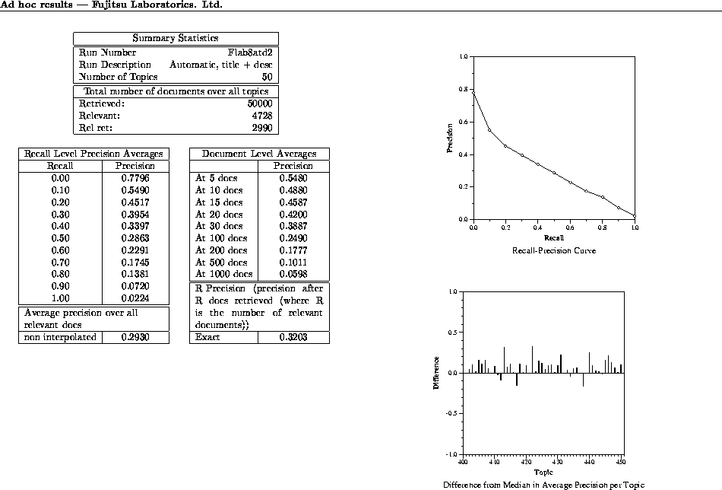
Dik Lun LEE Department of Computer Science, HKUST Slide <number>

Slide 52
Summary
Evaluation is essential
Precision and Recall (and Fallout) are still the main objective measurements although relevance judgment is rather difficult and a number of other metrics of effectiveness have been proposed
The Text Retrieval Conferences provide a source of a large database of documents, search statements and expected results from searches essential to evaluating algorithms
Acceptable retrieval systems must be ease to use, reliable, effective and inexpensive.
Dik Lun LEE Department of Computer Science, HKUST Slide <number>

